Slide 1
NewsELA Overview

Slide 2
Key Advantages
Articles for all disciplines.
Articles can be adjusted for each student’s individual reading needs.
Each article has a quiz attached that is aligned with the SBAC writing prompts and questions.

Slide 3
Access
Each teacher has an account in NewsELA -- connect through GMail once account is set-up.
Setup is similar to Google Classroom where students join class through a pre-set code.
Students can also be imported straight from Google Classroom.
Students access articles through a “binder” where teacher has pre-selected specific articles that have been assigned to the students.

Slide 4
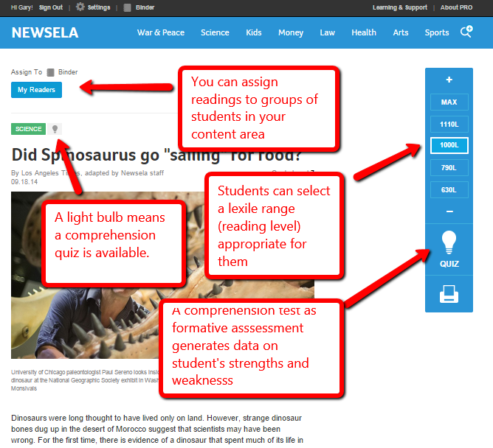
NewsELA Program
Some articles are translated to Spanish.
All articles have the option of having a different Lexile score. For assigned articles, the teacher assigns the Lexile score. For students just searching, they can change the Lexile score to their preference.

Slide 5
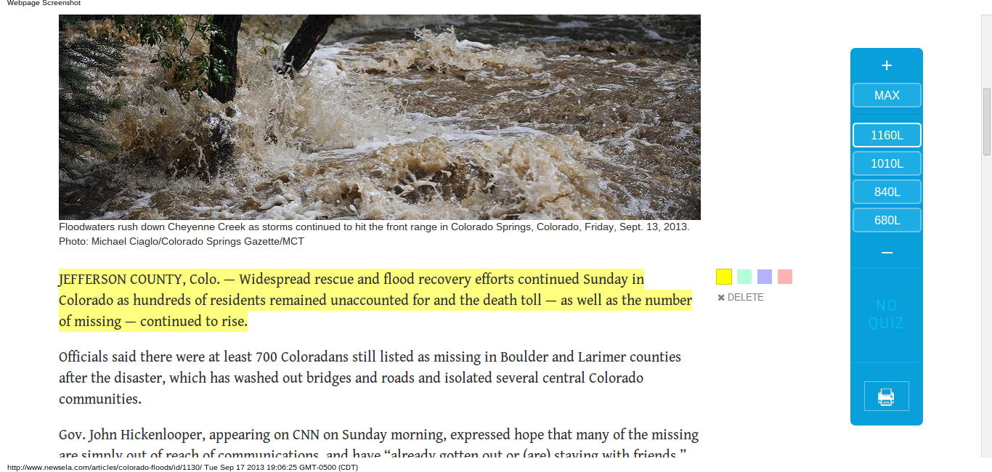
NewsELA Program
Annotation abilities to foster critical reading.
Able to create a text set to create a bundle of articles that pertain to a specified topic.
Text sets also available that have been created by NewsELA.

Slide 6
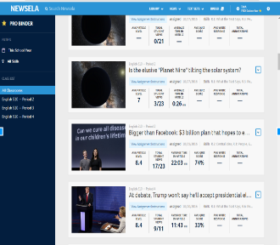
Teacher Binder
Teacher Binder allows you to see all of the articles you have assigned and the students’ progress. Various statistics are provided for re-teaching purposes.

Slide 7
Adaptative
Based on the grade level the teacher sets for the class, the reading level assigned by the teacher, and how the students perform over time data is collected to determine the student's’ reading level.
The text becomes adaptive based on the Lexile level and News ELA provides data on the student's’ reading level to the teacher.

Slide 8
Search and Navigation with NewsELA

